Slide 1
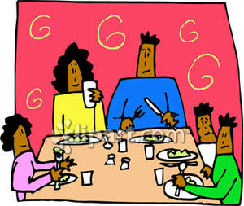
3.2 Using de and contractions with de to show ownership and relationships.
de + le = du
de + la = de la
de +l’ = de l’
de + les = des
DVD tutor definite article
DVD tutor contractions with de

Slide 2
Use de alone with a name
Marc’s book
the book of Marc
le livre de Marc
le frère de Yvette

Slide 3
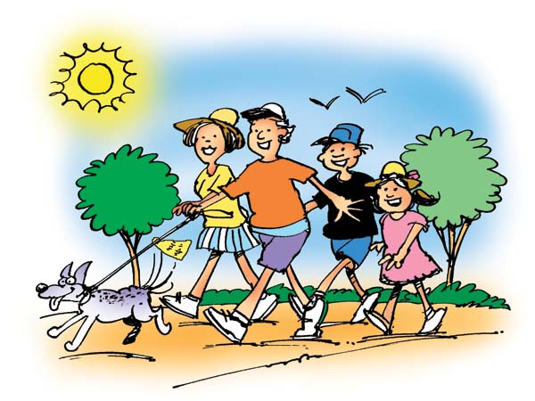
Use de la in front of a feminine noun
the family’s dog
the dog of the family
le chien de la famille
la tante de la fille

Slide 4
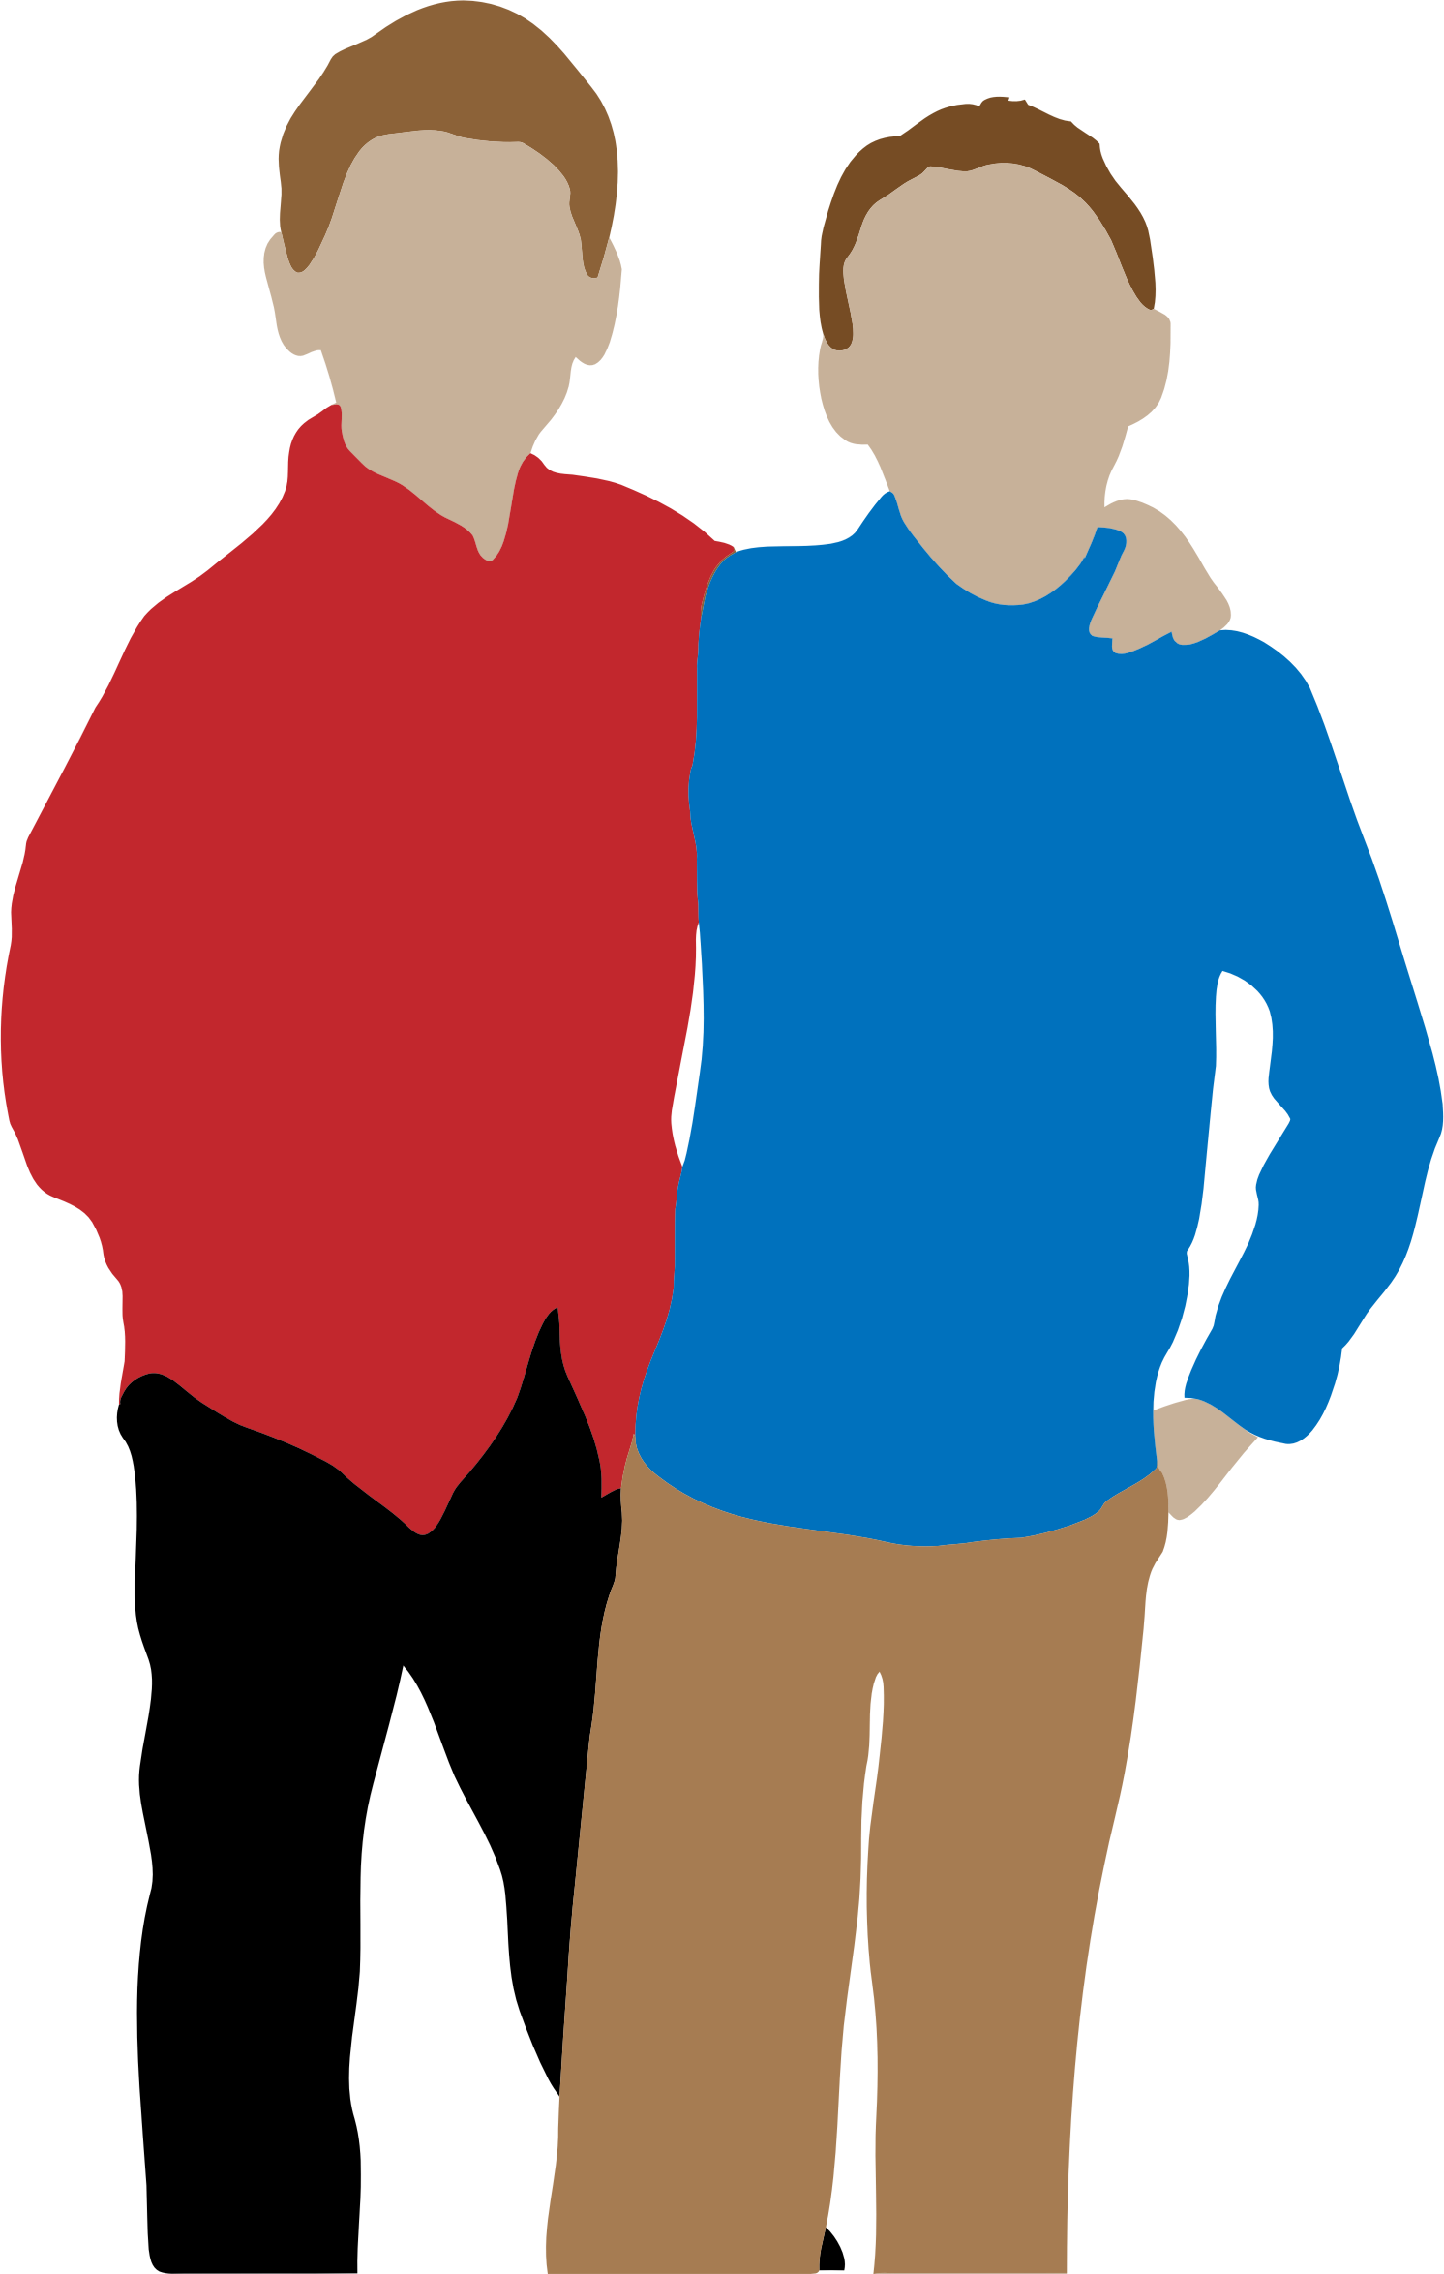
Use the contraction du in front of a masculine noun
the boy’s cousin
the cousin of the boy
le cousin du garcon
le bureau du prof

Slide 5
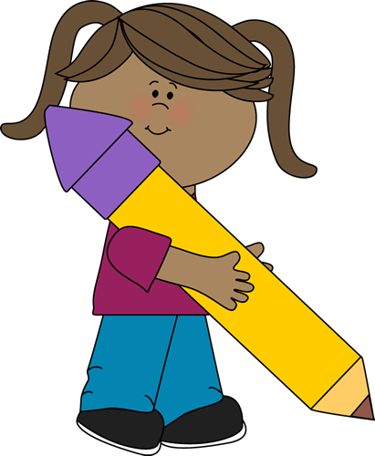
Use de l’ in front of nouns with a vowel or h
the student’s pencil
the pencil of the student
le crayon de l’élève
l’enfant de l’homme

Slide 6
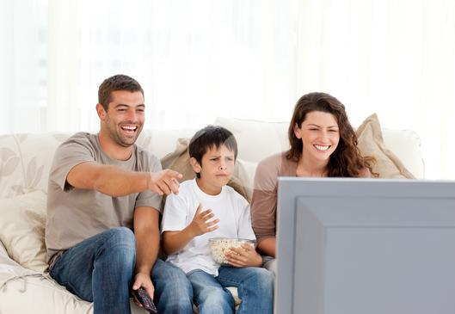
Use the contraction des with plural nouns
the parents’ television
the television of the parents
la télé des parents

